Slide 1

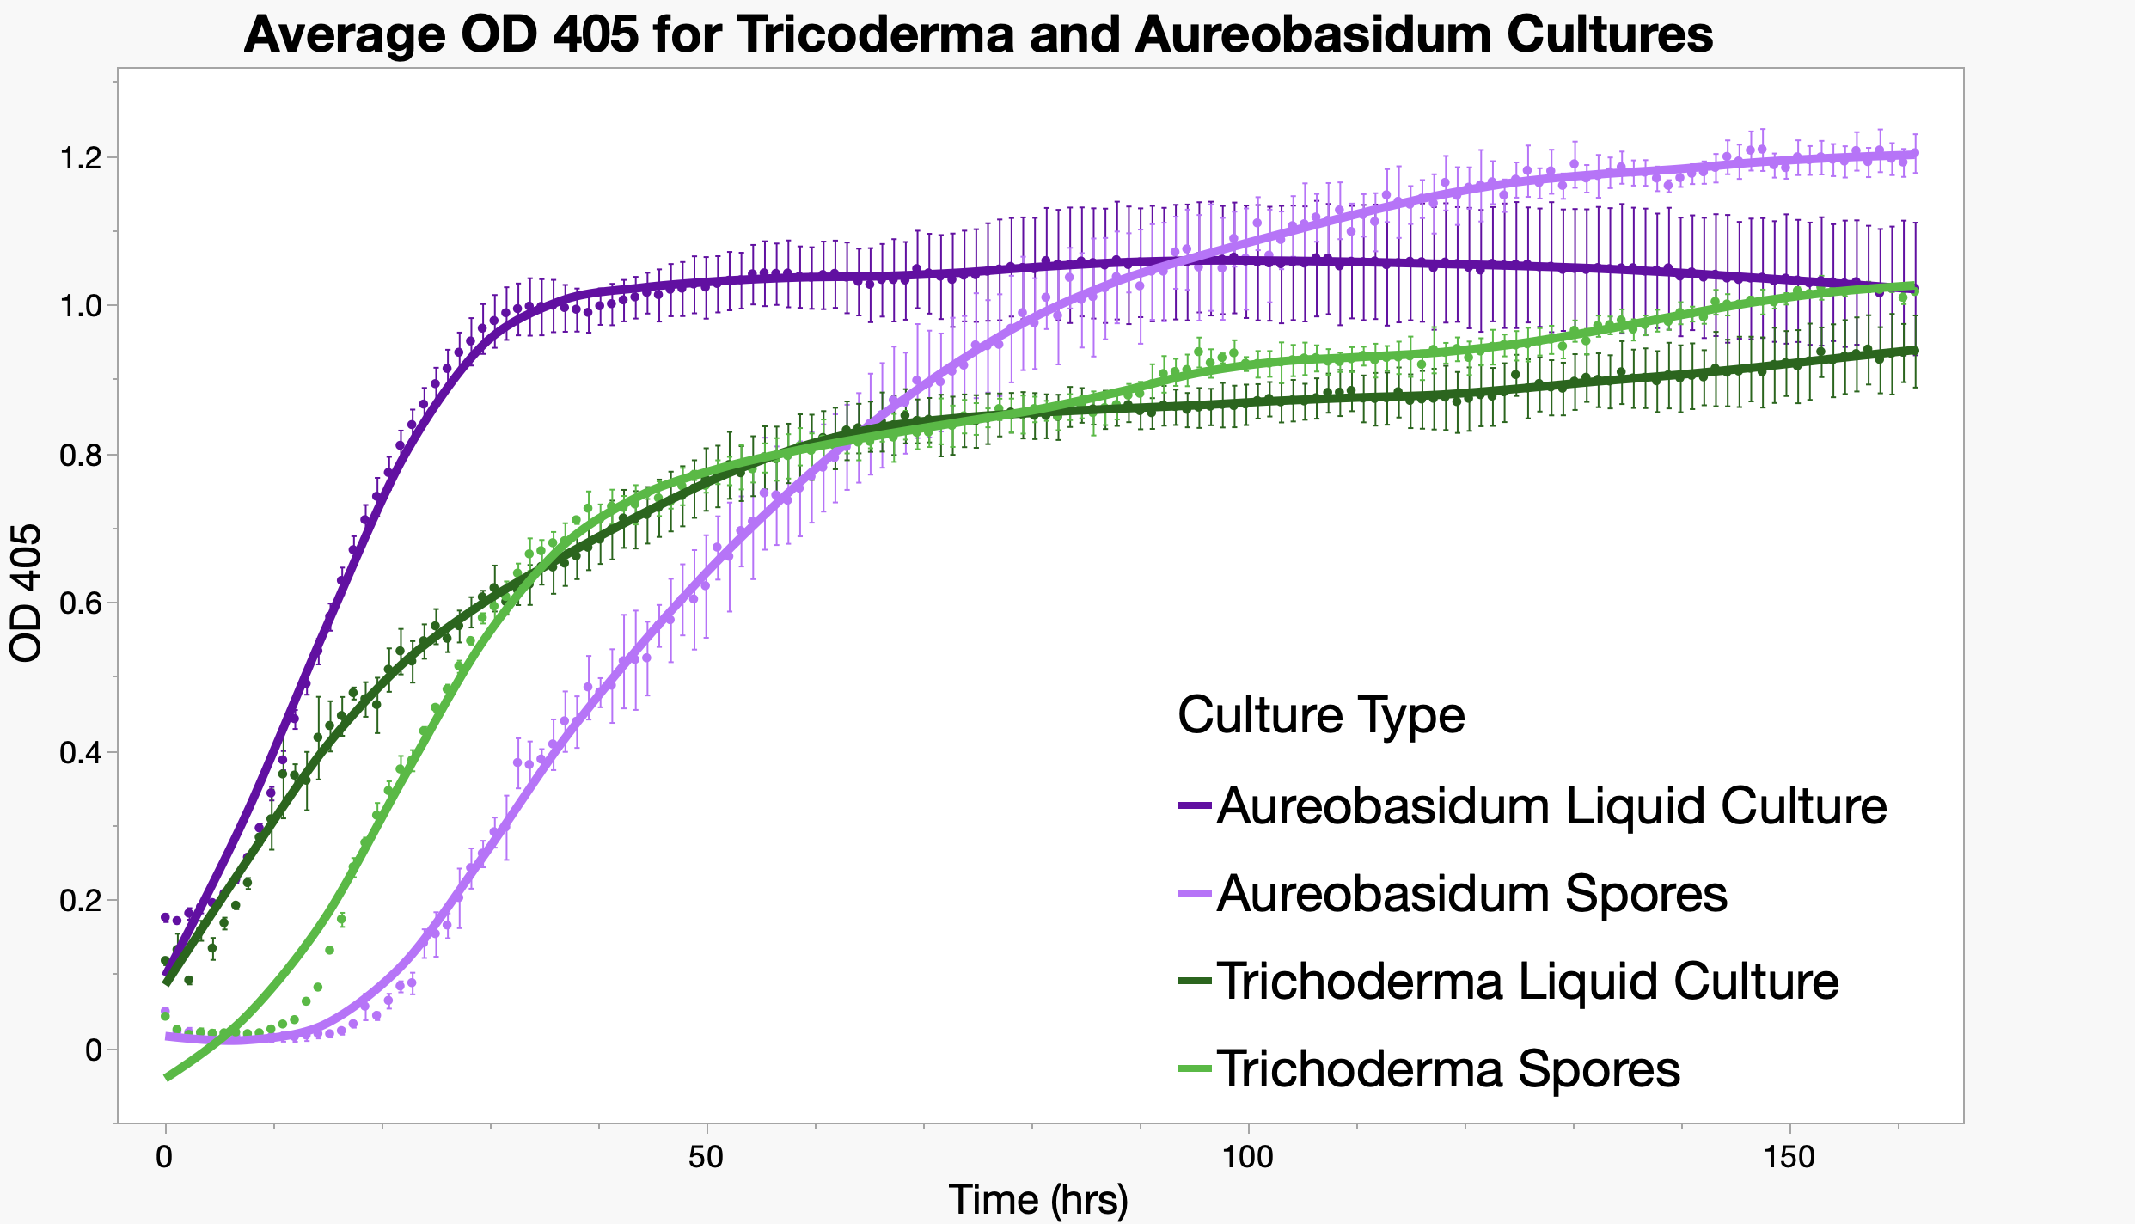
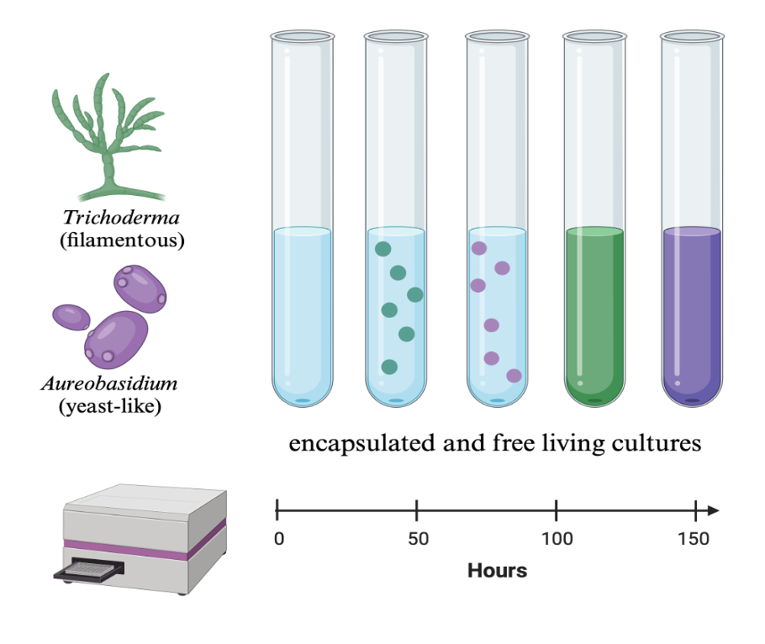
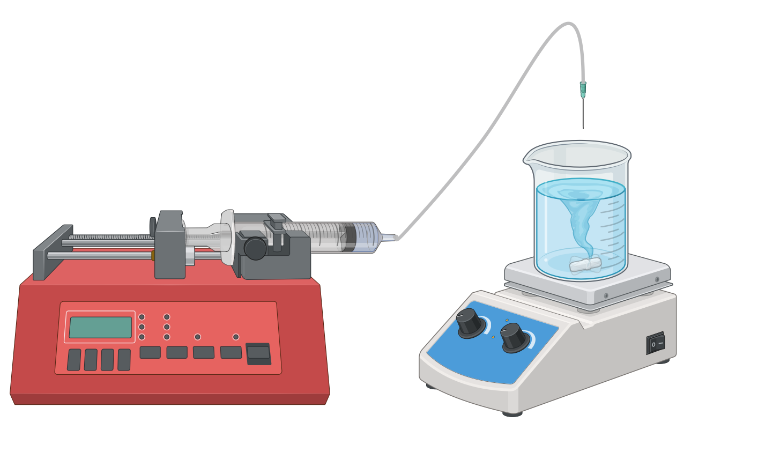




The Effect of Microencapsulation on the Growth of the Fungal Genera Trichoderma and Aureobasidium
Erica Babusci and Claudia K. Gunsch
Department of Civil and Environmental Engineering, Duke University
D u k e
U N I V E R S I T Y
614-600-6861
Erica.babusci@duke.edu
A
Background
Results
EPA Superfund sites classify locations with hazardous levels of containments, posing potential health risks to humans and the environment^{[1].} PAHs are a group of chemicals often found at Superfund sites due to their mutagenic and carcinogenic properties^{[2,3]}.
There are numerous strategies implemented to remediate PAH contamination, many being ecologically intrusive^{[4]}. A sustainable and cost-effective alternative is mycoremediation. However, minimal success in PAH degradation has been seen due to planktonic microbes not properly establishing within the novel environment^{[5]}.
This project utilizes known PAH degrading microbes isolated from a PAH contaminated Superfund site^{[6]}. Though this project, we aim to develop methods to encapsulate fungal genera and quantify growth and viability. Ultimately, this research will work to promote the survival and delivery of PAH degrading microbes back into the environment^{[7]}
A
Objectives
Figure 3: Growth curve for free cultures of Aureobasidium (purple) and Trichoderma (green). Cultures were grown at 30°C in a 24-well plate. Triplicates were done for each group and values were corrected based on blanks.
B
Determine if encapsulated fungal cultures exhibit better growth compared to planktonic cultures
Investigate whether different fungal morphologies (filamentous vs. yeast-like) display distinct growth trends in encapsulated conditions
Quantifying Fungal Growth
Overnight cultures and spore solutions of both genera Trichoderma and Aureobasidium were grown for 150 hours in triplicate. This was done to determine what optical density (OD) between 405nm, 500nm, and 600 nm, is a good proxy for fungal growth. OD 405nm was determined to be the most accurate proxy, depicted above.
Fungal Morphology
Preliminary results show that the filamentous fungi, Trichoderma, showed a higher OD405 value compared to the free-living culture after 150 hours. However, the yeast-like fungi, Aureobasidium, showed a lower OD 405 than the free-living culture after 150 hours. Results indicate that yeast-like fungi might not be optimal for encapsulation.
Methods
Monocultures
Fungal isolates were previously isolated from sediments of the Elizabeth River, Virgina. From the isolates, select strains from Trichoderma and Aureobasidium genera were selected for their differing morphologies and known PAH degrading capabilities.
Monocultures were then grown in Malt Extract (ME) medium at 30°C as both free living and encapsulated cultures.
Fungal Encapsulation
Capsules were generated via extrusion using a 1% sodium alginate solution and 10% bacterial culture through a 30G needed into 0.1M calcium chloride bath^{[8]}
Measuring Growth
OD405 was used to measure fungal growth of the medium surrounding the capsule to quantify the release of fungi. Capsules were dissolved in sodium citrate and plated to quantify the total fungal concentration^{[9]}
Figure 4 (A-B): Growth curve depicting the relationship between encapsulated (purple) and free (green) cultures of Trichoderma (A) and Aureobasidium (B). OD 405nm was taken in 30-minute increments for 150 hours in a 24-well plate at 30 C. Samples were done in triplicate, with each replicate duplicated. Values were averaged and plotted and a single line.
Future Directions
References and Acknowledgements
Figure 1: Schematic showing the planktonic vs encapsulated cultures and the different genera and morphologies being studied
Spike in model PAHs to encapsulated and planktonic monocultures to observe changes in PAH degradation
Inoculate PAH degrading micro-communities from Elizabeth River sediment.
Encapsulate micro-community and compare viability, community resilience, and PAH degradation to the planktonic counterpart.
Spike in Bacillus Velezensis to the micro-community and track how PAH degradation differs
Incorporate growth data into a model that helps predict the time frame needed for PAH degradation
[1] US EPA (2023), Superfund [2] Di Giulio, R. T., & Clark, B. W. (2015). J Tox and Env Health [3] Baek, et al. (1991) Water Air Soil Pollut. [4] Seo, J.-S., Keum, Y.-S., & Li, Q. X. (2009). Bacterial Degradation of Aromatic Compounds. [5] Omokhagbor Adams et al., (2020) International Journal of Environmental Bioremediation & Biodegradation [6] Valdivia-Rivera, et al. (2021). Reviews in Environmental Science and Bio/Technology. [7] Volkoff, et al. (2019) Duke University. [8] Yueng, et al. (2016) Front. Microbial. [9] Meletiadis, et al. (2001) ASM Journals
This material is based upon work supported by the National Institute of Environmental Health Sciences Under Grant No. P42ES010356
Figure 2: Syringe pump setup for producing microcapsules via extrusion

